Slide 1
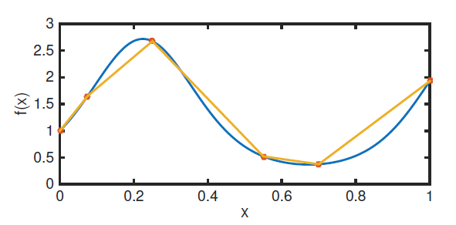
Chapter 5 Interpolation and Calculus

Slide 2
Interpolation
We are interested in this on several levels.
We can:
Approximate data if we have just the right amount of data for the functions we want to use
Approximate functions
Develop error formulae for the difference between the interpolant and a given function
Develop methods for approximating derivatives and integrals (calculus)
We will mostly focus on the last three

Slide 3
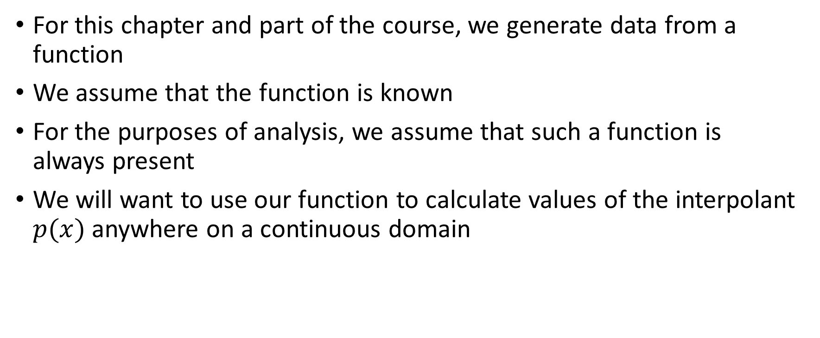
Interpolation
For this chapter and part of the course, we generate data from a function
We assume that the function is known
For the purposes of analysis, we assume that such a function is always present
We will want to use our function to calculate values of the interpolant $p(x)$ anywhere on a continuous domain

Slide 4
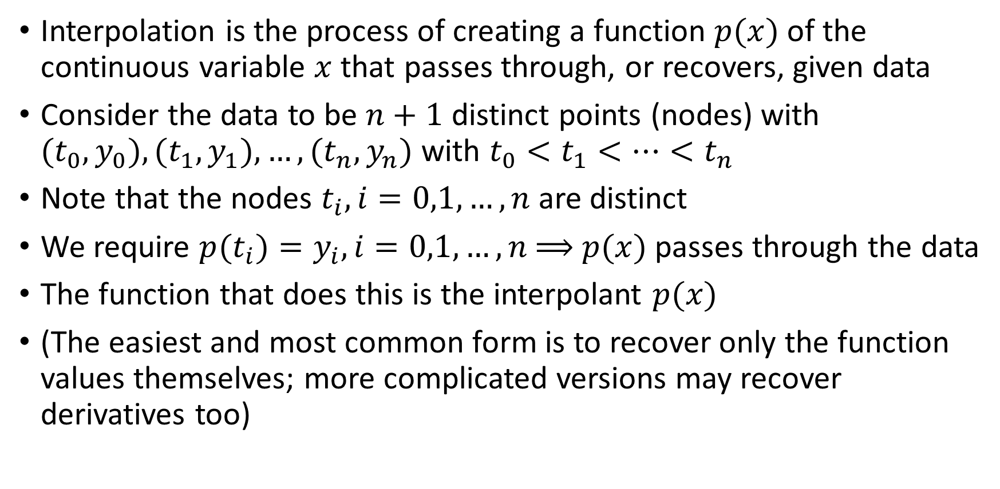
Interpolation
Interpolation is the process of creating a function $p(x)$ of the continuous variable $x$ that passes through, or recovers, given data
Consider the data to be $n+1$ distinct points (nodes) with $(t_{0},y_{0}), (t_{1},y_{1}),…,(t_{n},y_{n})$ with $t_{0}<t_{1}<…<t_{n}$
Note that the nodes $t_{i}, i=0,1,…,n$are distinct
We require $p(t_{i})=y_{i}, i=0,1,…,n$⟹ $p(x)$ passes through the data
The function that does this is the interpolant $p(x)$
(The easiest and most common form is to recover only the function values themselves; more complicated versions may recover derivatives too)

Slide 5
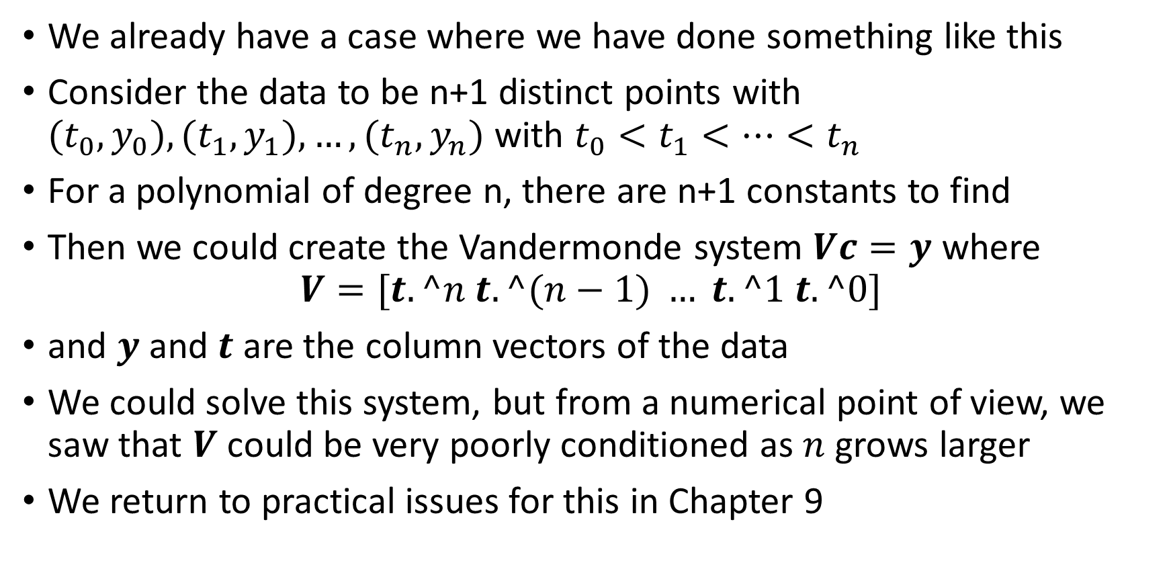
Interpolation
We already have a case where we have done something like this
Consider the data to be n+1 distinct points with $(t_{0},y_{0}), (t_{1},y_{1}),…,(t_{n},y_{n})$ with $t_{0}<t_{1}<…<t_{n}$
For a polynomial of degree n, there are n+1 constants to find
Then we could create the Vandermonde system $Vc=y$ where
$$V=[t.^n t.^(n−1) … t.^1 t.^0]$$
and $y$ and $t$ are the column vectors of the data
We could solve this system, but from a numerical point of view, we saw that $V$ could be very poorly conditioned as $n$ grows larger
We return to practical issues for this in Chapter 9

Slide 6
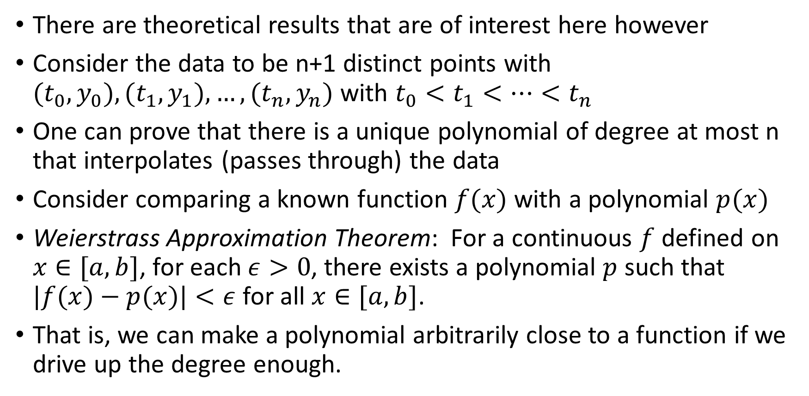
Interpolation
There are theoretical results that are of interest here however
Consider the data to be n+1 distinct points with $(t_{0},y_{0}), (t_{1},y_{1}),…,(t_{n},y_{n})$ with $t_{0}<t_{1}<…<t_{n}$
One can prove that there is a unique polynomial of degree at most n that interpolates (passes through) the data
Consider comparing a known function $f(x)$ with a polynomial $p(x)$
Weierstrass Approximation Theorem: For a continuous $f$defined on $x∈[a,b]$, for each $ε>0$, there exists a polynomial $p$ such that $|f(x)−p(x)|<ε$for all $x∈[a,b]$.
That is, we can make a polynomial arbitrarily close to a function if we drive up the degree enough.

Slide 7
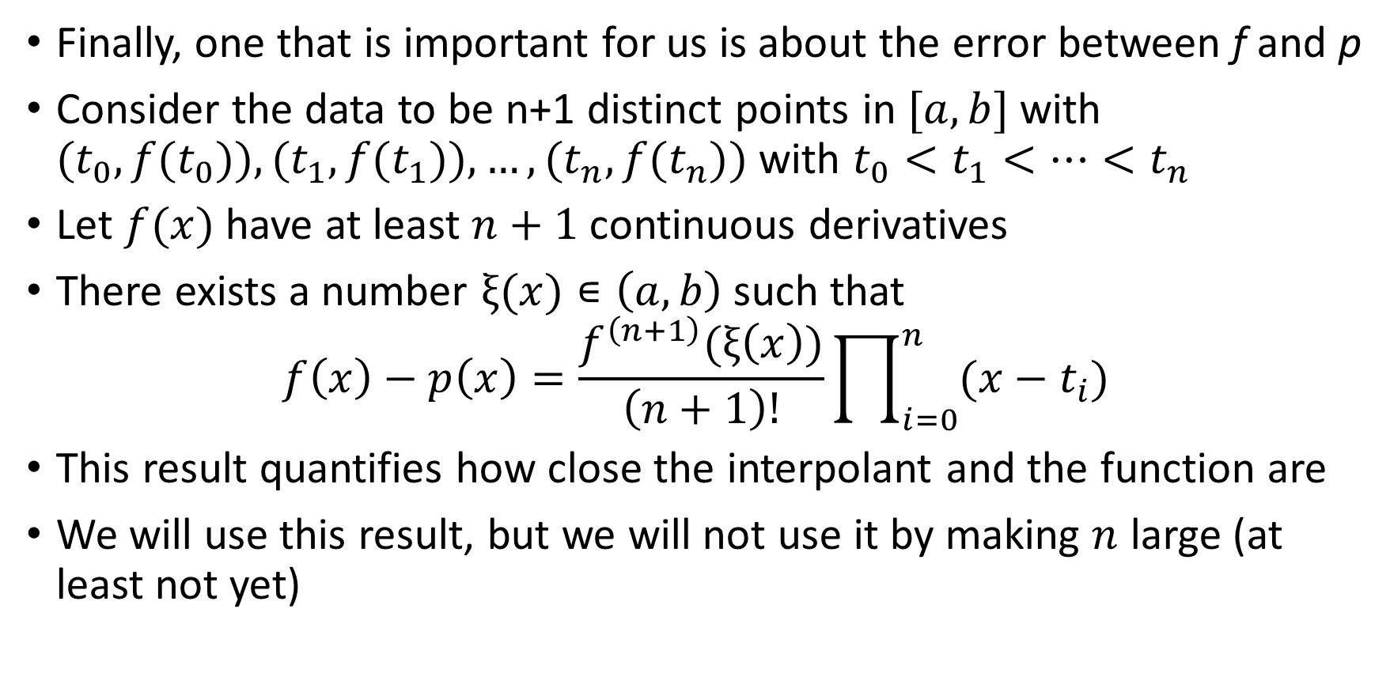
Interpolation
Finally, one that is important for us is about the error between f and p
Consider the data to be n+1 distinct points in $[a,b]$with $(t_{0},{f(t}_{0})), (t_{1},{f(t}_{1})),…,(t_{n},{f(t}_{n}))$ with $t_{0}<t_{1}<…<t_{n}$
Let $f(x)$ have at least $n+1$ continuous derivatives
There exists a number $ξ(x)∊\left(a,b\right)$ such that
$$f\left(x\right)−p\left(x\right)=\frac{f^{\left(n+1\right)}(ξ\left(x\right))}{\left(n+1\right)!}\prod_{i=0}^{n}{(x−t_{i})}$$
This result quantifies how close the interpolant and the function are
We will use this result, but we will not use it by making $n$ large (at least not yet)

Slide 8
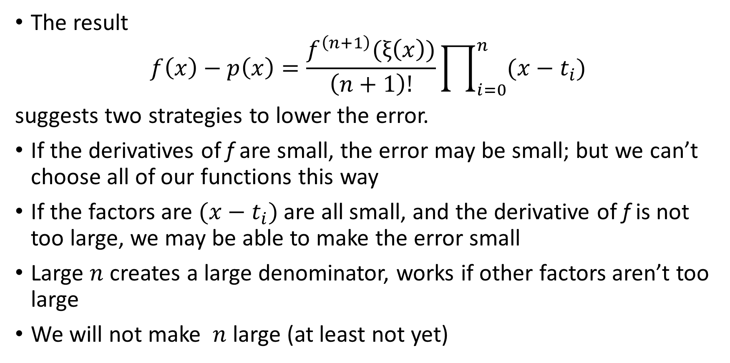
Interpolation
The result
$$f\left(x\right)−p\left(x\right)=\frac{f^{\left(n+1\right)}(ξ\left(x\right))}{\left(n+1\right)!}\prod_{i=0}^{n}{(x−t_{i})}$$
suggests two strategies to lower the error.
If the derivatives of f are small, the error may be small; but we can’t choose all of our functions this way
If the factors are $(x−t_{i})$are all small, and the derivative of f is not too large, we may be able to make the error small
Large $n$ creates a large denominator, works if other factors aren’t too large
We will not make $n$ large (at least not yet)

Slide 9

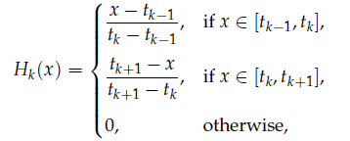
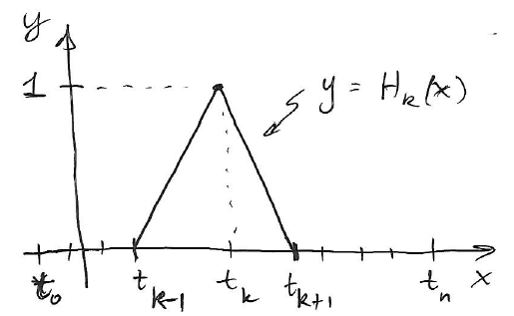
Piecewise linear interpolation
This is great for one interval, but is not so easy to generalize for all subintervals
Let’s rewrite how we do the pcwise linear interpolant
First, let’s create a simple “cardinal function” which returns 1 at a node of interest, and 0 at every other node:

Slide 10
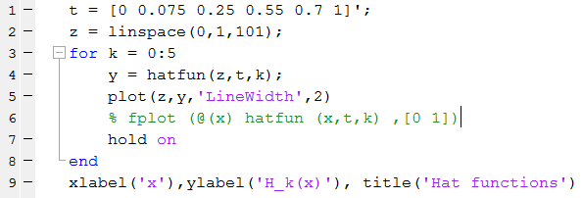
Piecewise linear interpolation
This will allow us to draw hats or tents with a 1 at each node
Here’s a way to do it in Matlab:
Uses textbook hat function

Slide 11
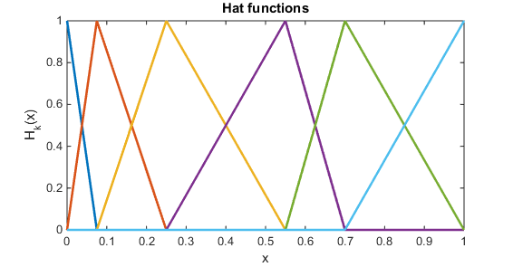
Piecewise linear interpolation
The nodes are the six given t values.
Each color is one hat function
Ends have half of one
Let’s look at details

Slide 12
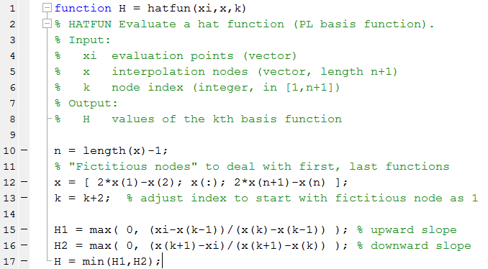
Piecewise linear interpolation
Text Matlab function:

Slide 13
Piecewise linear interpolation
Text Matlab function:
Sets max value starting from 0 index

Slide 14
Piecewise linear interpolation
Text Matlab function:
Add extra points with same spacing as ends in given data

Slide 15
Piecewise linear interpolation
Text Matlab function:
Shift index to start at 1

Slide 16
Piecewise linear interpolation
Text Matlab function:
Choose correct part of hat function from 4 possibilities

Slide 17
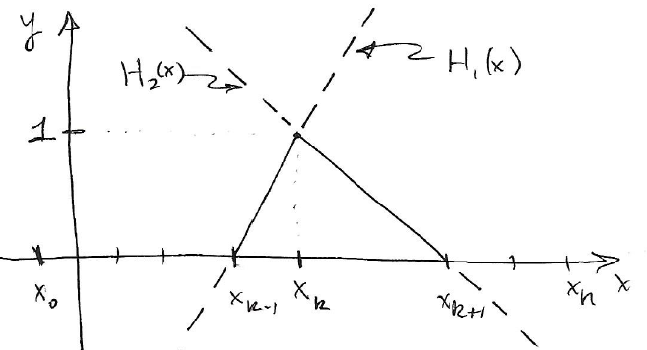

Piecewise linear interpolation
Here’s a sketch of parts of the hat function
For node $k$, $H_{1}(x)$ and $H_{2}(x)$ are sketched
We want the solid parts

Slide 18
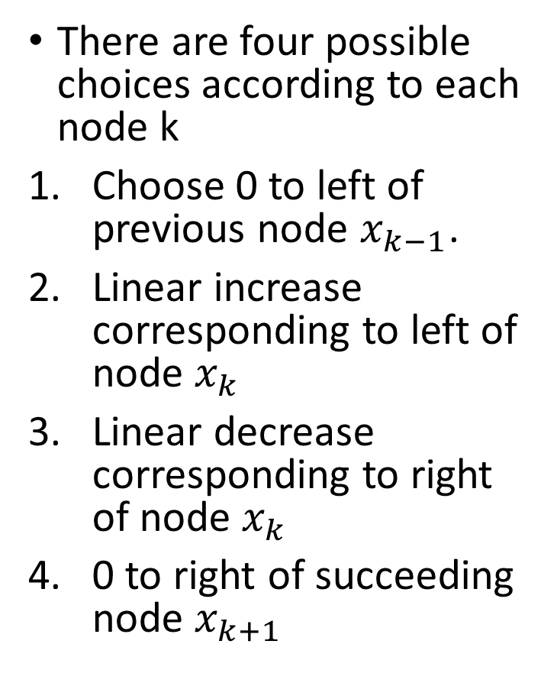
Piecewise linear interpolation
There are four possible choices according to each node k
Choose 0 to left of previous node $x_{k−1}$.
Linear increase corresponding to left of node $x_{k}$
Linear decrease corresponding to right of node $x_{k}$
0 to right of succeeding node $x_{k+1}$

Slide 19
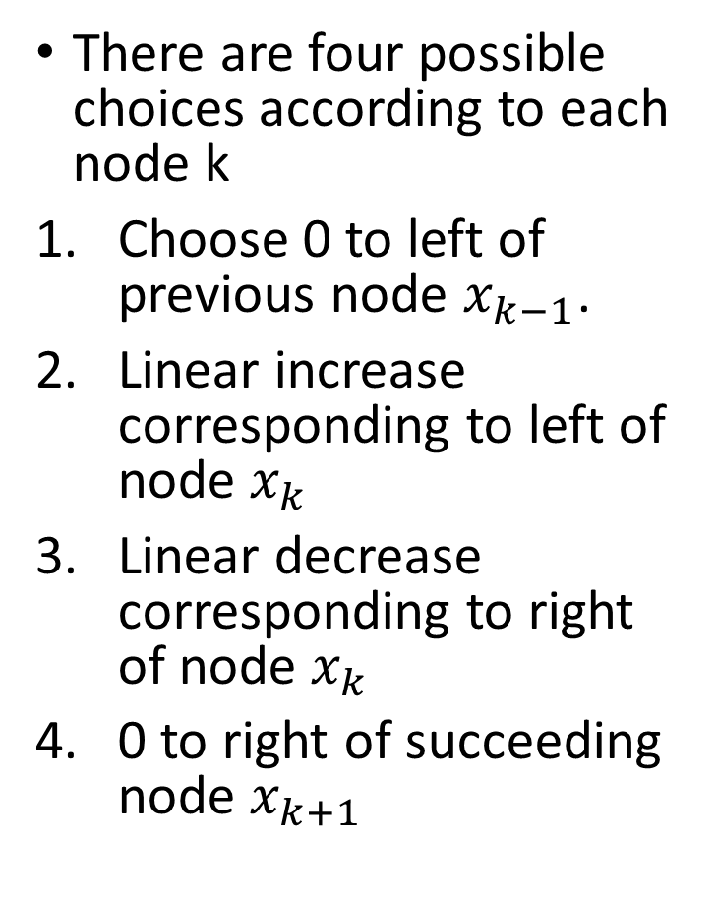
Piecewise linear interpolation
There are four possible choices according to each node k
Choose 0 to left of previous node $x_{k−1}$.
Linear increase corresponding to left of node $x_{k}$
Linear decrease corresponding to right of node $x_{k}$
0 to right of succeeding node $x_{k+1}$

Slide 20
Piecewise linear interpolation
There are four possible choices according to each node k
Choose 0 to left of previous node $x_{k−1}$.
Linear increase corresponding to left of node $x_{k}$
Linear decrease corresponding to right of node $x_{k}$
0 to right of succeeding node $x_{k+1}$

Slide 21
Piecewise linear interpolation
There are four possible choices according to each node k
Choose 0 to left of previous node $x_{k−1}$.
Linear increase corresponding to left of node $x_{k}$
Linear decrease corresponding to right of node $x_{k}$
0 to right of succeeding node $x_{k+1}$

Slide 22


Piecewise linear interpolation
We want to build the PL interpolant from
But, the hat functions satisy the “cardinal conditions” which returns 1 at a node of interest, and 0 at every other node:
This makes the algebra trivial…

Slide 23

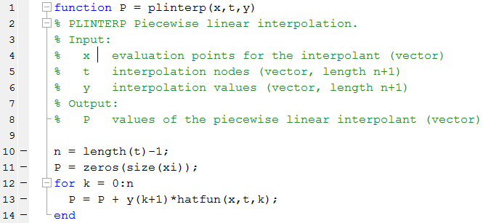
Piecewise linear interpolation
We can easily recover the data by requiring
This makes it easy to do this kind of interpolation once you can make the hat functions

Slide 24
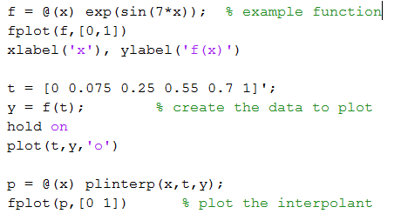
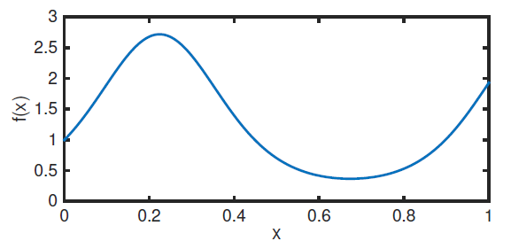
PL interpolation example

Slide 25
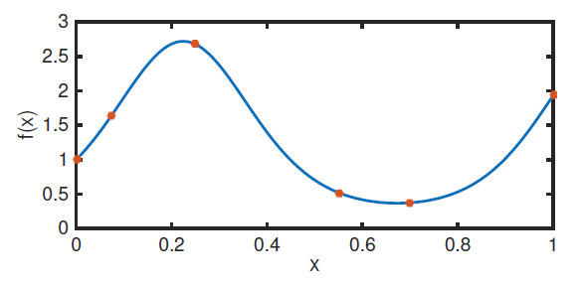
PL interpolation example

Slide 26
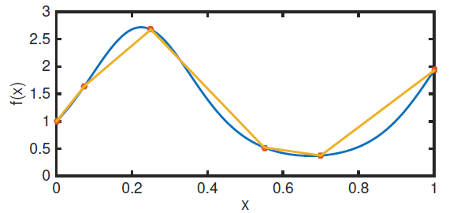
PL interpolation example

Slide 27

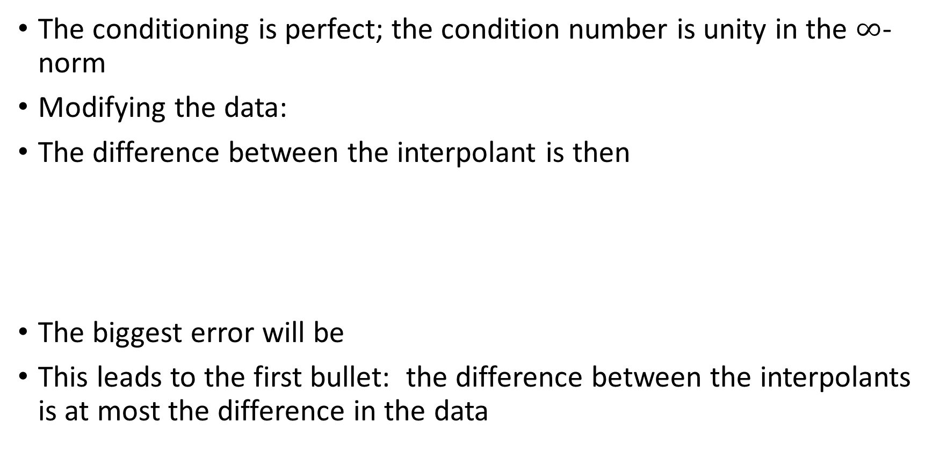
PL Interpolation
The conditioning is perfect; the condition number is unity in the $∞$-norm
Modifying the data:
The difference between the interpolant is then
The biggest error will be
This leads to the first bullet: the difference between the interpolants is at most the difference in the data

Slide 28


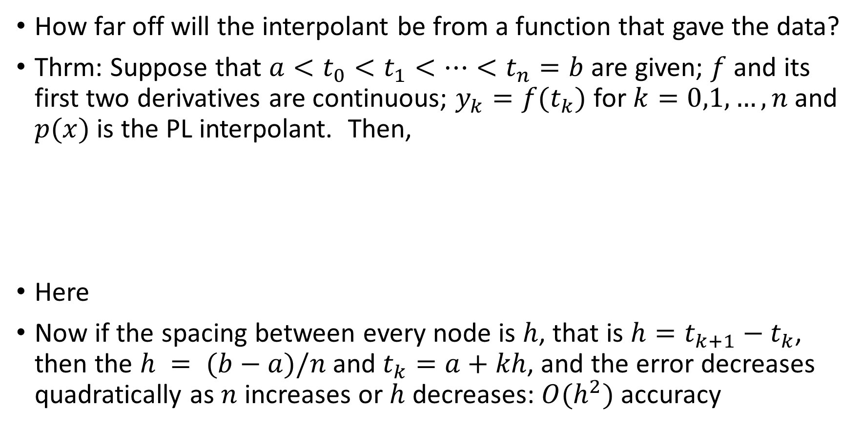
PL Interpolation
How far off will the interpolant be from a function that gave the data?
Thrm: Suppose that $a<t_{0}<t_{1}<…<t_{n}=b$are given; $f$ and its first two derivatives are continuous; $y_{k}=f(t_{k})$ for $k=0,1,…,n$ and $p(x)$ is the PL interpolant. Then,
Here
Now if the spacing between every node is $h$, that is $h=t_{k+1}−t_{k}$, then the $h = (b−a)/n$and $t_{k}=a+kh$, and the error decreases quadratically as $n$ increases or $h$ decreases: $O(h^{2})$ accuracy

Slide 29
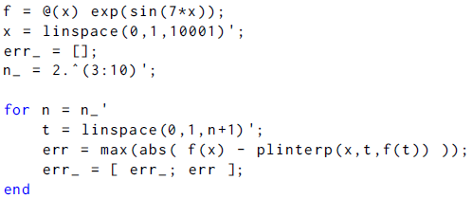
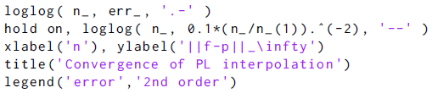
PL interpolation convergence
Example function
Comparison sequence
Compute error in lots of
node sets
Plot error and
comparison sequence

Slide 30
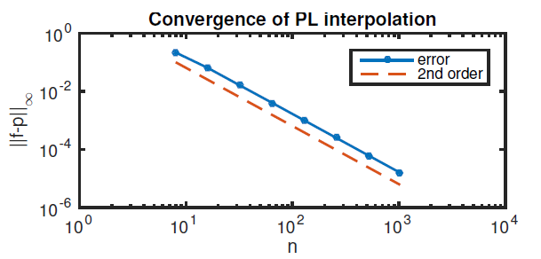
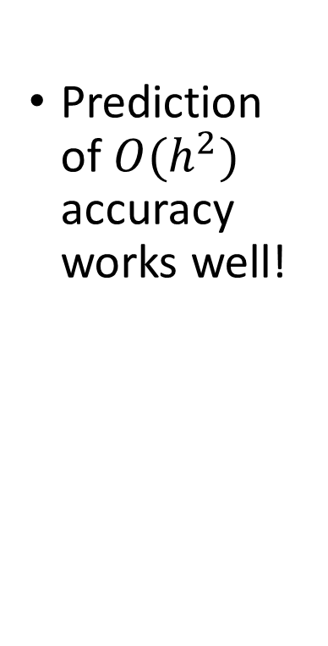
PL interpolation convergence
Prediction of $O(h^{2})$ accuracy works well!

Slide 31
Interpolation – Cubic splines
The result
$$f\left(x\right)−p\left(x\right)=\frac{f^{\left(n+1\right)}(ξ\left(x\right))}{\left(n+1\right)!}\prod_{i=0}^{n}{(x−t_{i})}$$
suggests two strategies to lower the error.
If the derivatives of f are small, the error may be small; but we can’t choose all of our functions this way
If the factors are $(x−t_{i})$are all small, and the derivative of f is not too large, we may be able to make the error small
Large $n$ creates a large denominator, works if other factors aren’t too large
We will not make $n$ large (at least not yet)

